Slide 1
“Market Volatility Pattern Analysis"
Data Cleaning, Key Findings, and Insights
By Vivek Kumar

Slide 2
Agenda
1.Data Cleaning Approach
2.Key Findings from Analysis
3.Most Significant Patterns Discovered
4.Technical Challenges Encountered

Slide 3
Data Cleaning Approach
Missing Values:
Removed rows with missing values using dropna() to ensure no incomplete data skewed the analysis.
Checked for NaN values in crucial columns and handled them.
Data Type Conversion:
Converted columns like Price, Volume, Close, Open, etc., from object to numeric using pd.to_numeric().
Ensured the data was in the correct format to perform mathematical operations.
Outlier Handling:
Used IQR to identify and highlight outliers in numerical data, such as prices and volumes.
Calculated upper and lower bounds to filter extreme outliers.
Date Conversion:
Ensured the Datetime column was in the correct datetime format for time series analysis.

Slide 4
Key Findings from Analysis
Correlation Insights:
Strong positive correlation between Close and Open prices.
Minor negative correlation between Volume and Price Change (weak relationship).
Price Distribution:
Close prices show a slight right skew (positively skewed).
Volume distribution is also slightly skewed with frequent higher volumes.
Price Fluctuations:
There were significant fluctuations in the Close Price observed at certain times of the day, with sudden increases in Volume.
Statistical Insights:
Standard deviation and skewness values helped identify periods of high volatility.
Kurtosis of Close Price distribution indicates heavy tails, pointing to occasional extreme price changes.

Slide 5
Most Significant Patterns Discovered
Volume vs. Price Change:
No strong linear correlation, suggesting that Volume doesn't directly predict Price Change.
However, large Volume spikes occasionally coincide with large price changes.
Open vs. Close:
Consistent relationship between Open and Close prices.
Scatter plot indicates a linear relationship, confirming the high correlation between the two.
Price Change and Volume:
Scatter plots showed no clear trend between Price Change and Volume, although there were outliers during periods of high volatility.

Slide 6
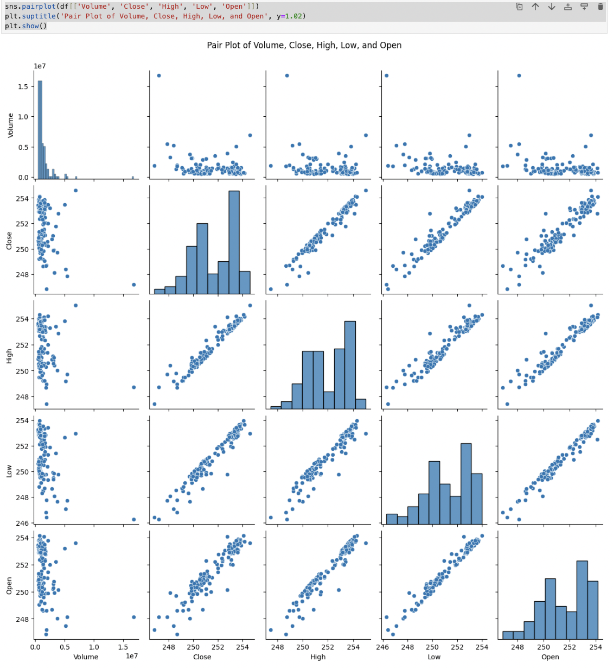
Visualizing the Insights
Pair Plot:
Displays correlations between Volume, Close, High, Low, and Open.
Clear relationship between Open and Close prices.

Slide 7
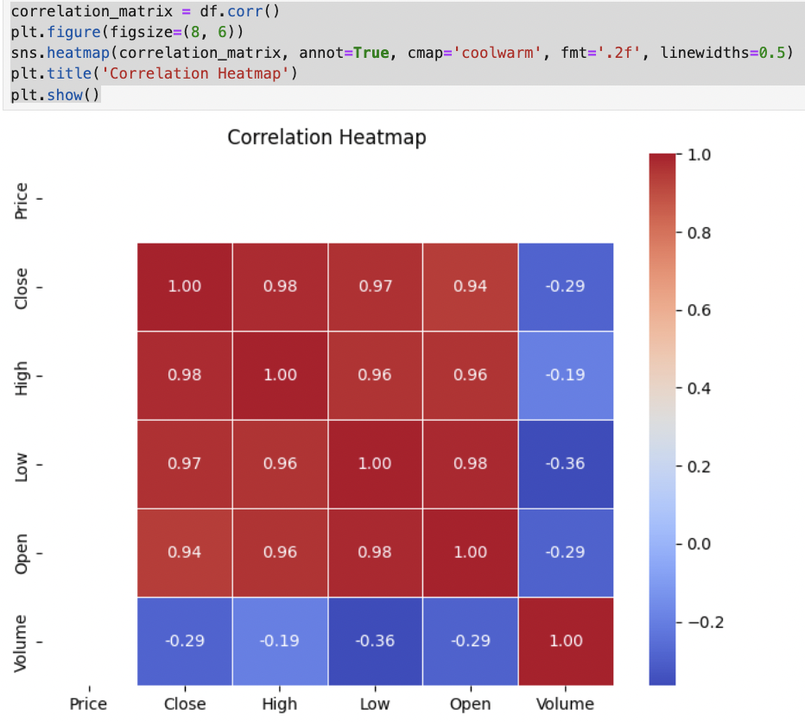
Visualizing the Insights
Correlation Heatmap:
Strong correlations observed between Close and Open.
Minimal correlation between Volume and other variables.

Slide 8
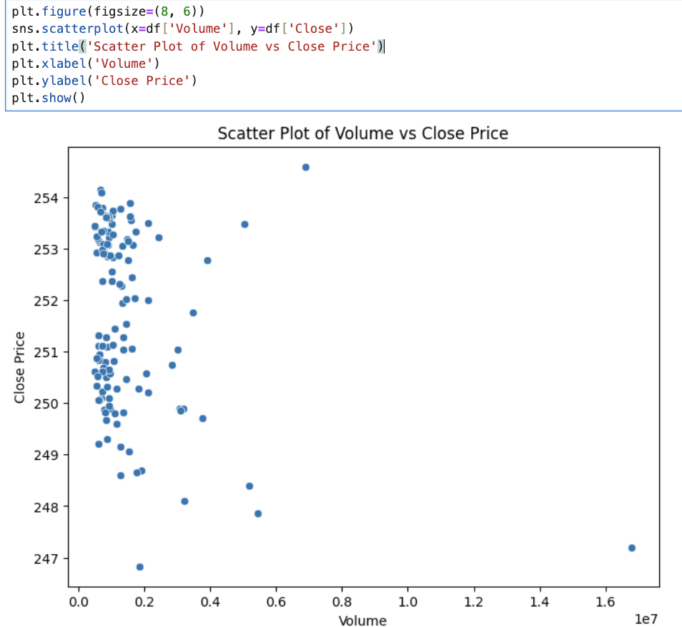
Visualizing the Insights
Scatter Plot:
Volume vs Price Change shows no strong relationship.

Slide 9
Technical Challenges Encountered
Data Quality:
Inconsistent data types in the original dataset.
Handling missing or NaN values for accurate analysis.
Time Series Data:
Properly converting and handling datetime format was challenging.
Working with intraday data and ensuring correct indexing.
Outlier Detection:
Identifying meaningful outliers without distorting the overall dataset.
Data Conversion:
Converting object columns to numeric types without affecting data integrity.
High Volume Data:
Large volumes of data with fine-grained intervals (15-minute intervals) made visualization and analysis computationally intensive.

Slide 10
Conclusion
The analysis provided key insights into AAPL's stock performance, focusing on intraday price movements and trading volume.
The data cleaning process ensured the data was suitable for statistical analysis, leading to actionable insights.
Future analysis could incorporate additional features such as market sentiment or technical indicators for a more comprehensive prediction model.
Project Link-
https://drive.google.com/file/d/1OPVbXhfuAGkJ3Cm-Eu_muvkzuyI-yDXA/view?usp=drive_link

Slide 11
THANK YOU !!

